Slide 1
THE GULF OF MEXICO:
RISING STAR OR
OVER THE HILL?
by
Richard Nehring
NRG Associates
The Natural Gas Frontier: 2015 and Beyond
Annual Energy Outlook 2001 Conference
March 27, 2001

Slide 2
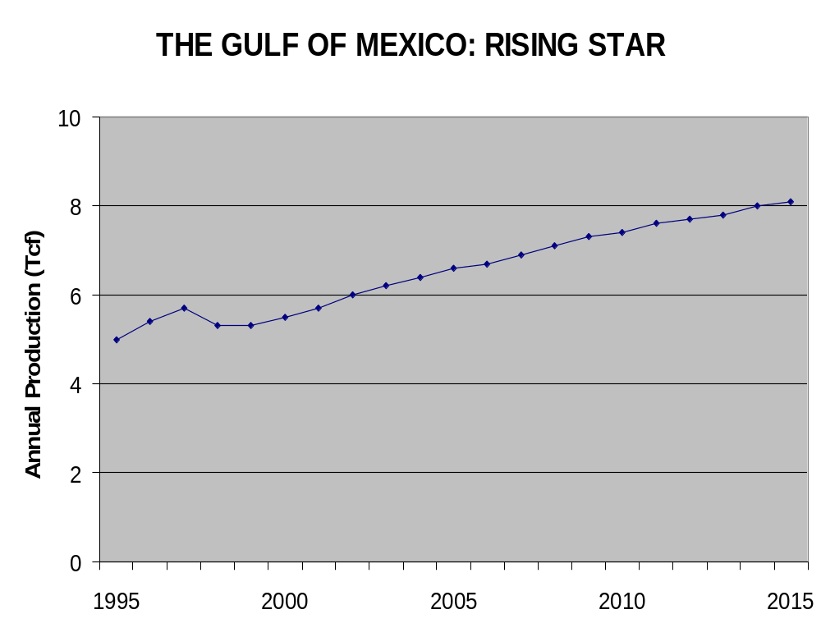

Slide 3
IMPLICATIONS OF THE RISING STAR CASE
1999-2015 Reserve Additions of 126 Tcf
• 71% of 1998 GOM EUR of 177.3 Tcf
1999-2015 Average Reserve Additions of 7.4
Tcf/year
• 2011-2015 Average Reserve Additions of 8.5 Tcf/year
• Compare to 1983-1998 Average of 4.3 Tcf/year

Slide 4
THE BASIC METHODOLOGY OF THE RISING STAR CASE
“If you drill them (wells),
it (increased production) will come.”
a.k.a. “The Gas Field of Dreams” approach to gas supply forecasting

Slide 5
Fundamentals of Gulf of Mexico Gas Resources
The U.S. Gulf of Mexico is a World Class Gas Province
• 177.3 Tcf known recovery as of the end of 1998
• One/sixth of total U.S. known gas resources
• Second only to the adjacent onshore Gulf
Coast Basin
• Concentrated on OCS Shelf
• OCS Shelf - 146.1 Tcf
• State Shelf - 22.7 Tcf
• OCS Deepwater - 8.5 Tcf

Slide 6
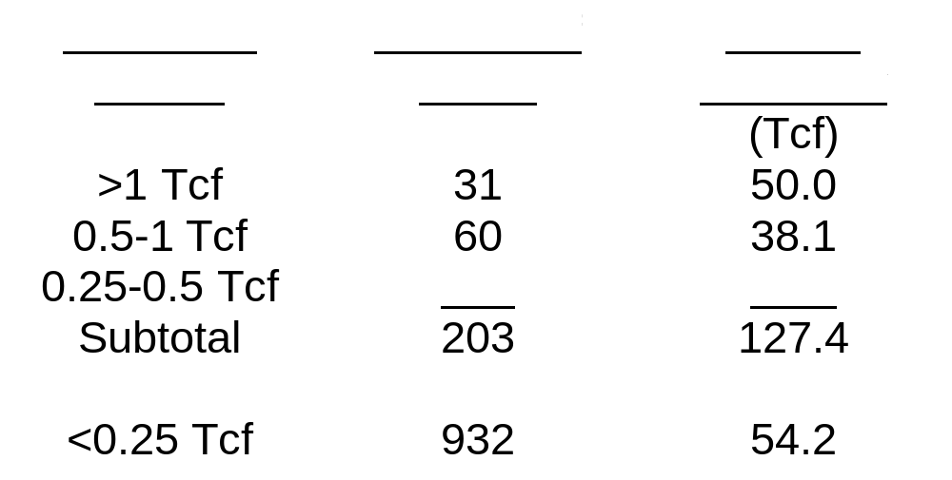
Fundamentals (2)
Gulf of Mexico Gas Resources are Concentrated in Large Fields
The Gulf of Mexico thus Differs from most
other World Class Petroleum Provinces

Slide 7
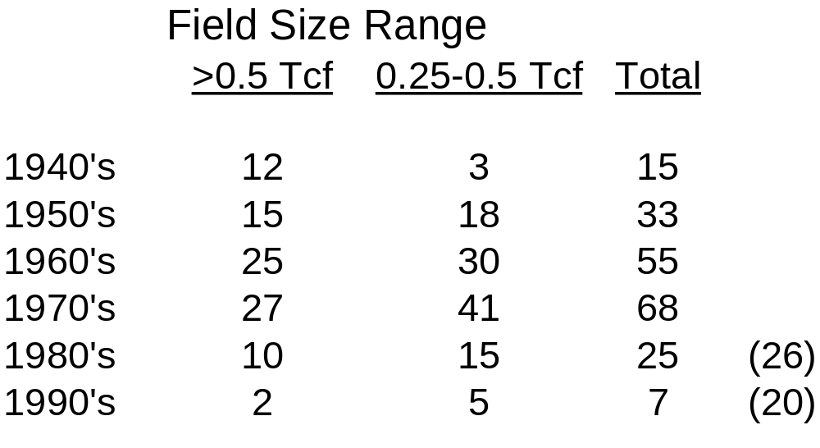
Fundamentals (3)
Large and Giant Fields Are Discovered Early in the Exploration Process
Discoveries of Large Gas Fields in the Gulf of Mexico by Decade

Slide 8
Fundamentals (4)
Less than half of all discoveries made by 1979, but 80% of all large discoveries
1980’s and 1990’s large discoveries are mostly deepwater (and mostly casinghead gas); large shelf discoveries were predominantly deep Norphlet and eastern Main Pass

Slide 9
How the Past Will Shape the Future: The Shelf
Recent High Rates of Reserve Additions
• 31.0 Tcf from 1983 to 1990
• 27.2 Tcf from 1991 to 1998
New Field Discoveries are Diminishing
• 30% of reserve additions from 1983- 1990
• 16% of reserve additions from 1991- 1998

Slide 10
The Shelf (2)
Both the Number and the Average Size of New Field Discoveries are Decreasing
Shelf Reserve Additions Maintained in 1990’s by Reworking Old Fields With 3-D Seismic
• How Much More Is Possible?
• What is the Potential Below 15,000 ft?

Slide 11
How the Past Will Shape the Future: Deepwater
More Amounts of Petroleum Being
Discovered
• More than 165 Fields with 15 billion BOE
But Mostly Liquids (70%), Not Gas (only
30%)
Liquids Becoming Increasingly
Predominant in Past Five Years
Most of Deepwater Now Established as
Oil-Prone

Slide 12
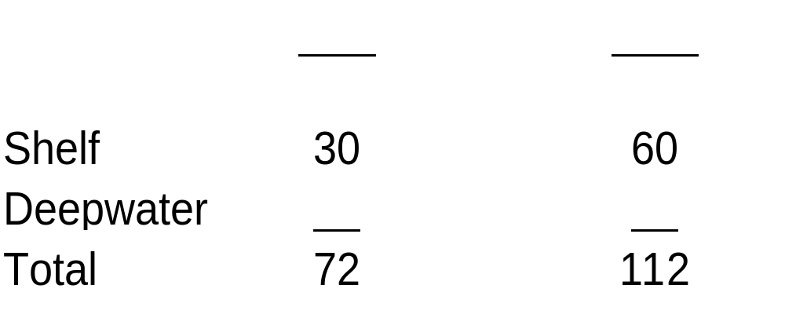
Projected GOM Gas Reserve Additions, 1999-2015 (Tcf)
Implies continued high rates of annual reserve additions
• 4.2 Tcf/year in the low case
• 6.6 Tcf/year in the high case
These rates accelerate in the next 4 to 8 years, then decline as opportunities are depleted

Slide 13
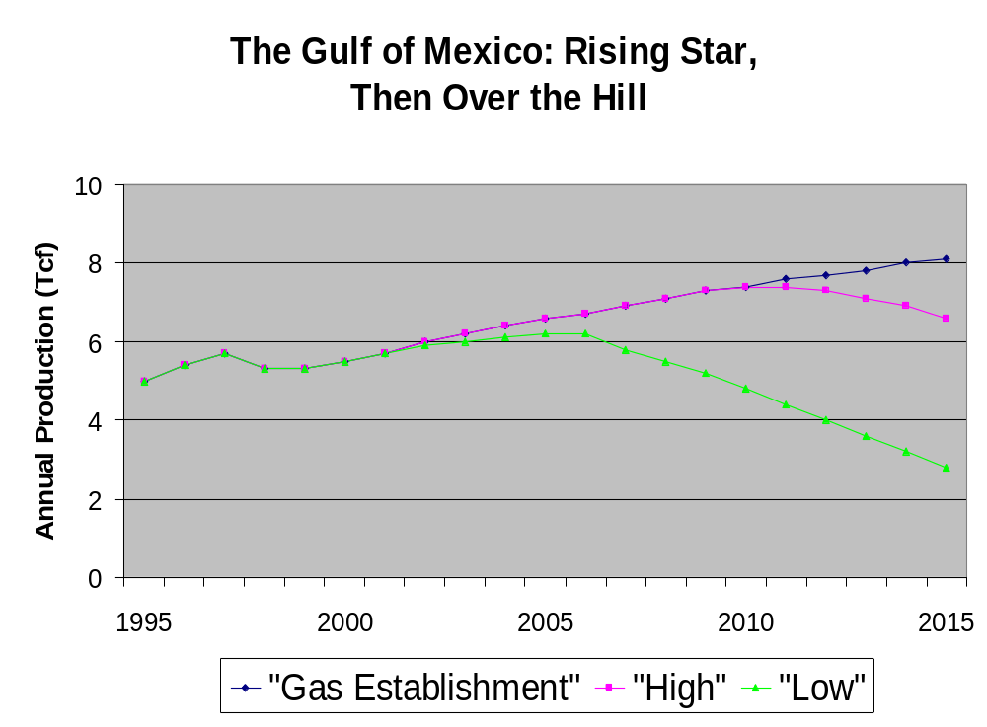

Slide 14
Conclusions
Rising Star Through 2005
Over the Hill by 2007-2012
Timing of the Latter Unlikely to be Apparent Until 2005
Domestic Gas Supply Planners Cannot Rely on Gulf of Mexico For an Indefinite Future

